Slide 1
Turbine performance
Power Curve Working Group, Glasgow, 13 December 2016
Alex Head, Przemek Marek, Matthew Colls, Joel Manning
Notes:
Thanks Peter
Hello
Pleased to once again be able to share some of our recent work on turbine performance variations

Slide 2
About Prevailing
Experts in wind farm yield
Over 1200 wind farms analysed in 25 countries
Developer, Lender and Acquisitions roles
Pre-construction and operational
UK, Munich and Portland, OR.
Notes:
Brief intro to Prevailing Ltd for those of you who haven’t worked with us yet

Slide 3
Evolution of turbine performance prediction
Sales power curve only
Single adjustment factor
1 parameter models
2 parameter models
3 parameter models: RWSR/TI/Unorm
?
Notes:
We’ve come a long way already. Through the hundreds of yield assessments we have reviewed during acquisitions, we still see all of the above.
The last model is our current approach – presented at AWEA 2 years ago.
RWSR is rotor wind speed ratio, which you can see as “rotor normalised shear” really. It reflects the level of angle of attack variation around the rotor.
Unorm is the wind speed normalised by the rated power wind speed at zero turbulence. This is a normalised parameter determining turbine control phase: cut in, cubic, rated transition.

Slide 4



Why is performance inaccurately estimated?
Many reasons, but let’s focus on one today:
Performance models historically rely on correlation not causation
≠
Notes:
Correlation lets us learn from experience.
Understanding causation lets us predict what will happen in new situations.

Slide 5
Good causation examples
Shear changes turbine performance:
Local angle of attack variations → Changes to the lift to drag ratio → Turbine performance variation.
Turbulence changes the power curve knee:
Larger wind speed variations → Rated power affects high gusts not low gusts → Reduction in average power.
Notes:
Some aspects of turbine performance are already understood in causal ways.
Some aren’t.

Slide 6
Observed performance
Unorm = 0.7 – cubic section of power curve
Rotor wind speed ratio
Turbulence intensity
 | 2% | 4% | 6% | 8% | 10% | 12% | 14% | 16% | 18% | 20% | 22% | 24%
1.7 | 79% | 78% | 83% | 80% | 88% | 88%
1.6 | 79% | 82% | 85% | 87% | 90% | 89% | 90%
1.5 | 79% | 84% | 87% | 91% | 91% | 90% | 91% | 93% | 92% | 93%
1.4 | 80% | 86% | 88% | 91% | 94% | 96% | 96% | 96% | 95% | 99%
1.3 | 81% | 85% | 89% | 91% | 95% | 98% | 98% | 97% | 100% | 100% | 102% | 95%
1.2 | 81% | 88% | 90% | 92% | 96% | 98% | 100% | 100% | 102% | 104% | 103% | 106%
1.1 | 77% | 87% | 91% | 94% | 97% | 99% | 102% | 103% | 105% | 107% | 107% | 109%
1.0 |  | 89% | 93% | 96% | 98% | 100% | 101% | 104% | 105% | 105% | 111% | 103%
0.9 |  |  |  |  |  |  | 94% | 95% | 95% | 96% | 102%
0.8 |  |  |  |  |  |  | 90% | 93% | 92% | 95% | 97%
0.7 |  |  |  |  |  |  | 88% | 89% | 92% | 90% | 94%
?
Notes:
Specific example:
Middle of the power curve.
Turbulence has a big effect on performance.
Why?

Slide 7
Possible causes
Cubic averaging of power curve
More laminar flow over blades (earlier stall)
Atmospheric stratification
Temperature → Viscosity → Reynolds No. → L/D ratio
Other effects?
Notes:
But how much does it happen?

Slide 8
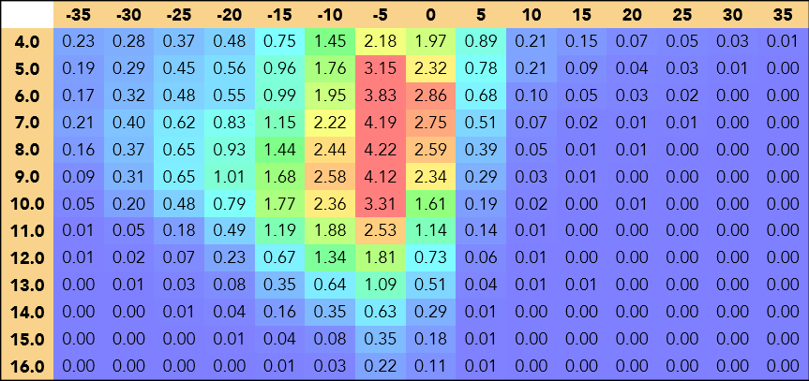
How much does veer happen?
Rotor equivalent Veer
Wind speed (m/s)
13.2 %
Notes:
The numbers for each bin are percentages of the total time
When the veer is 15 degrees or more for wind speeds which are on the cubic section of the power curve we can safely state that veer will have a significant influence on turbine performance.
For this site these conditions are present 13.2% of the time – i.e. A significant proportion.
Site is mid-west US.

Slide 9
Does veer affect performance?

Slide 10
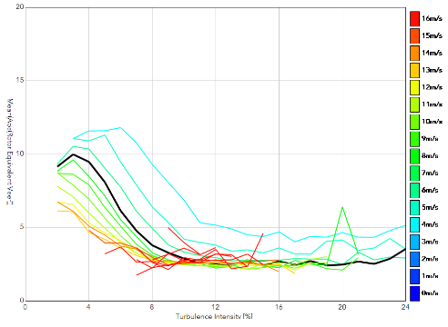
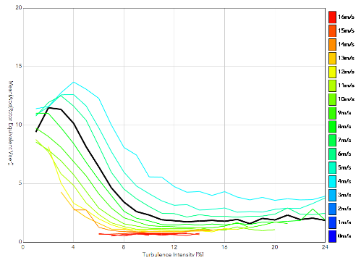
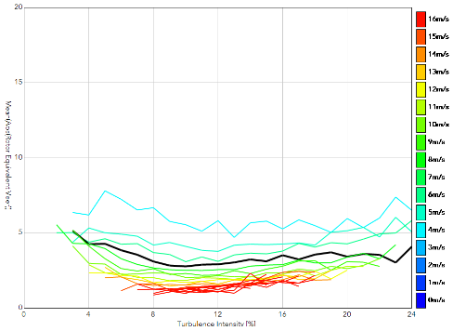
Same turbulence, different veer

Slide 11
Current Conclusions
Correlation = learning from experience.
Causation allows prediction to new situations with more confidence.
Turbulence often explains much of performance variation, but with opaque causality.
Veer causes significant performance variation.
Veer correlates with low turbulence, but not at all sites.

Slide 12
Where from here?
We currently consider veer to ensure our performance assumptions are appropriate.
Fully integrate veer measurements from pre-construction data into our turbine performance model.
Gradual erosion of non-causal performance metrics.

Slide 13
Thank you
Thanks again to our data contributors
Send us your PPT data!
Operators, we’ll send you free results in exchange for your data.
Manufacturers, we’d welcome engagement.
Matthew.colls@prevailinganalysis.com
www.prevailinganalysis.com

